Slide 1
2023 EY Open Science Data Challenge - Level 1
To develop a predictive model that can detect the presence, or non-presence of rice field at a given location based on satellite data. (Binary classification)

Slide 2
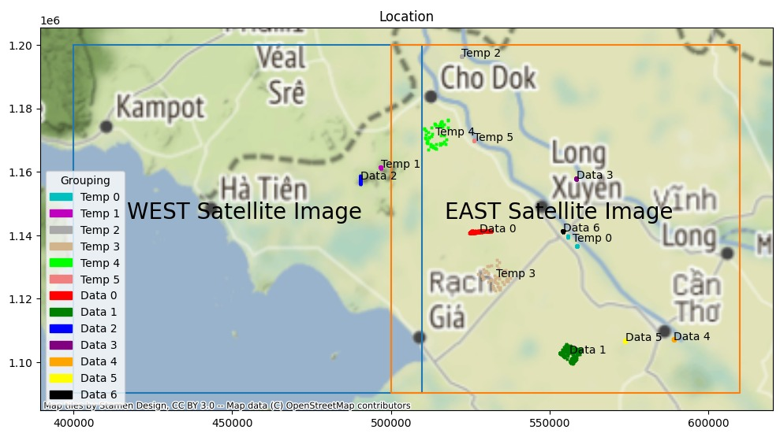
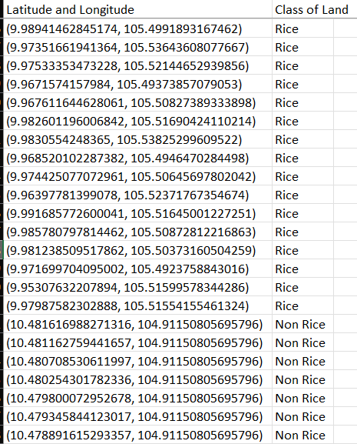
Dataset
Satellite data for the 600 data points are sampled based on various conditions to provide comprehensive information for the model to classify the rice fields.

Slide 3
Satellite Data Collection
The satellite data of various wavelength bands and dates is accessed through Microsoft Planetary Computer Hub stac API with Python.
Range of Dates: Jan 2021 - Dec 2021
Data Sources
Sentinel-1 (radar data): VH, VV (can penetrate cloud (useful for target site which has high moisture and is often cloudy))
Sentinel-2 (optical data) data: B01, B02, B03, B04, B05, B06, B07, B08, B8A, B09, B11, B12, SCL, WVP, visual. (more informative visually but unable to penetrate cloud)

Slide 4
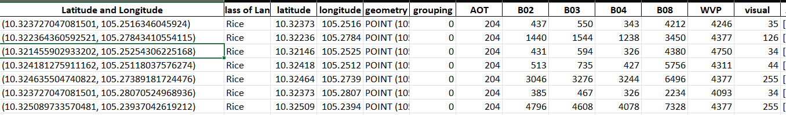
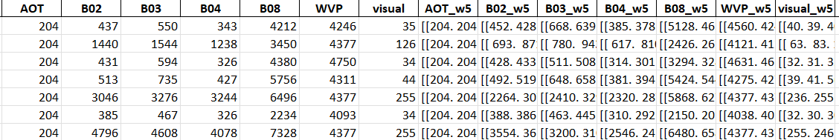
Collected Data
Satellite data collected is saved in multiple files with each of them containing satellite data of a particular source (s1 or s2) and date. e.g. LEVEL1_SENTINEL-2-L2A_2021-02-09 with satellite data collected from Sentinel 2 for 2021-02-09 along with their corresponding coordinates.is shown below.
Satellite data
Satellite data
Each column indicates a column with specific wavelength band and window size, e.g. B02_w5:
B02: wavelength band
W5: window with width and height of 5 pixels
Each cell consists of an array of pixel values for its respective band and coordinate in the window.
Window height
One of the sample coordinates
Window width

Slide 5
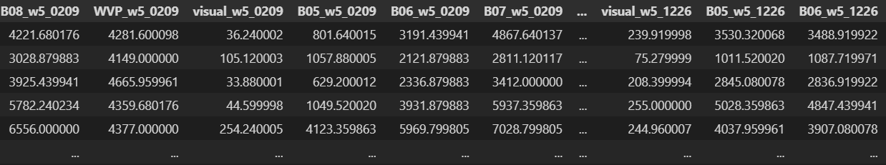
Data Preprocessing
Multiple files are combined and aggregated to include information from multiple wavelength bands and dates as data for model development.
Each column contains data with specific wavelength, window size and date, e.g. B02_w5_0209:
B02: wavelength band
W5: original window width and height of 5 pixels which are aggregated into a single value with mean.
0209: date of which satellite data is collected
Input data is in a structured table format.
LEVEL1_SENTINEL-2-L2A_2021-02-09
LEVEL1_SENTINEL-2-L2A_2021-08-18
LEVEL1_SENTINEL-2-L2A_2021-12-26
+… +
+… +
Combine multiple files
Aggregate arrays to become single values
Sample of aggregated data.

Slide 6
Model Development Experiments
Hypothesis
Validation
Model Development

Slide 7
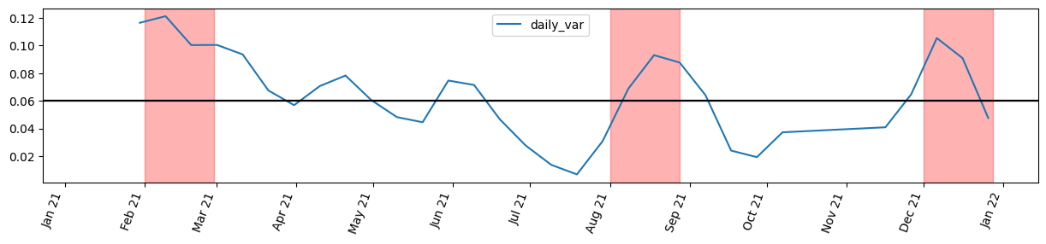
Assumption 1: NDVI is the most important differentiator
In this case, we assume that the density of greenness of earth surface is the most important differentiator between different land covers. So, we selected data from the months with peaks in NDVI of rice fields compared with the average NDVI of all land covers, i.e. February, August and December. .
Iteration 3 (most important breakthrough: cloud is might be the most important factor)
test score = 0.94 / 0.95
we tried adding Sentinel-1 data to the model stacking method used in iteration 2, which improves our model performance significantly. F1-score = 0.94 / 0.95 based on the normalization method we use (MinMax and RobustScaler performs better). To help readability, we will only illustrate experimentation with MinMaxScaler.
- Sentinel-2: Feb, Aug, Dec raw data + NDVI
- Sentinel-1: Sentinel-1 raw data data + VH / VV
- drop highly correlated features
- normalization (StandardScaler, MinMaxScaler, RobustScaler)
- stack models
Iteration 4
test_score = 1.0
As we observe that the inclusion of Sentinel-1 data in `iteration 3` significantly improves our prediction accuracy, we assume that cloud is the most important factor in this classification task. We conduct cloud analysis and find out the dates with the least amount of cloud throughout the year. Based on the dates, we extract their corresponding Sentinel-1 and Sentinel-2 data. increased window size to 9*9 to reduce the impact of possible cloud covering the window.
- cloud15 data
- drop highly correlated features
- normalization (Robust)
- stack models

Slide 8
Evolution of Models + Test F1-scores
Based on the dataset queried based on the NDVI variance assumption, satellite data for February, August and December is used to develop classification models to predict the class of given coordinates
Iteration 1
test F1-score = 0.89
- Only Sentinel-2 data
- Random Forest
- window size of 5*5, aggregated by mean
Baseline model.
Iteration 2
test F1-score= 0.86
- all February, August, December data + NDVI
- window size of 5*5, aggregated by mean
- remove highly correlated features
- stack models
We assumed that stacking models + extracting NDVI might lead to improved performance increasing robustness. However,this approach reduced the F1-score when tested against unseen test data. These typical approaches are not the key to improve model performance.
Iteration 3
test F1-score= 0.95
- Sentinel-2: Feb, Aug, Dec raw data + NDVI
- Sentinel-1: Sentinel-1 raw data data + vh/vv
- drop highly correlated features
- normalization and stack models
Adding Sentinel-1 data to the configurations used in iteration 2 improved model performance significantly. New assumption: ability to remove the influence of cloud is the most important factor to increase model performance.
Iteration 4
test_score = 1.0
As we observe that the inclusion of Sentinel-1 data in `iteration 3` significantly improves our prediction accuracy, we assume that cloud is the most important factor in this classification task. We conduct cloud analysis and find out the dates with the least amount of cloud throughout the year. Based on the dates, we extract their corresponding Sentinel-1 and Sentinel-2 data. increased window size to 9*9 to reduce the impact of possible cloud covering the window.
- cloud15 data
- drop highly correlated features
- normalization (Robust)
- stack models

Slide 9
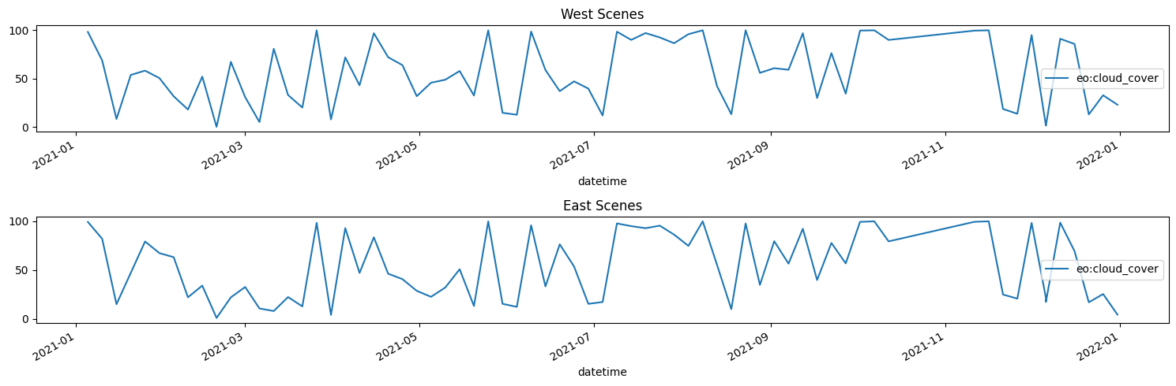
Assumption 2: Cloud Removal
As we observe that the inclusion of Sentinel-1 data in `iteration 3` significantly improves our prediction accuracy, we assume that cloud removal is the most important factor in this classification task. We conduct cloud analysis and find out the dates with the least amount of cloud hanging over the training sample coordinates throughout the year. Based on the dates, we extract their corresponding Sentinel-1 and Sentinel-2 data. We increased window size to 9*9 to reduce the impact of possible cloud covering the window.

Slide 10
Evolution of Models + Test F1-scores
Iteration 4
Test F1-score = 1.0 !!!
- take sentinel-1 and sentinel-2 data with <15% cloud coverage directly over our training data
- window size: 9*9, aggregated by mean
- normalization (MinMaxScaler)
- apply random forest classification
Based on the conditions established, we realise that we achieved a perfect F1-score of 1.0.
Iteration 4.1
Test F1-score = <1.0
- take sentinel-1 and sentinel-2 data with <15% cloud coverage directly over our training data
- window size: 9*9, aggregated by mean
- normalization (MinMaxScaler)
- remove highly correlated features
- apply random forest classification
Trying to simplify the classification model, removal of some highly correlated features results in reduction in test F1-score.
Iteration 4.2
Test F1-score = 1.0
- take sentinel-1 and sentinel-2 data with <15% cloud coverage directly over our training data
- window size: 9*9, aggregated by mean
- add NDVI and vh/vv features
- normalization (MinMaxScaler)
- remove highly correlated features
- apply random forest classification
By adding NDVI and vh/vv features to iteration 4.1, we achieve perfect F1-score of 1.0 again.

Slide 11
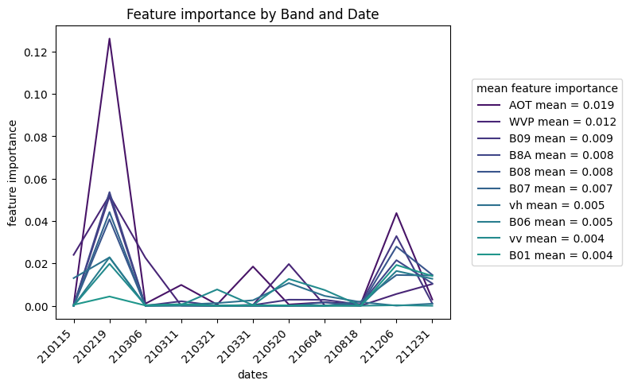
Highest Performing Features
Due to the large number of features and variation by time is involved, feature importance of the model is not easily interpretable.
In this case, we investigate the feature importance of each band for the dates chosen over the year. The plot shows the feature importances of the highest performing band over time.
Overall, ‘AOT’ and ‘WVP’ band have the highest average feature importance, but we notice that all bands have pretty small feature importance.

